Slide 1
Symmetric Matrices and Quadratic Forms
6.1 Diagonalization of Symmetric Matrices
Bumhee Cho

Slide 2







A Symmetric Matrix
A^{T} = A
square matrix
!
?
Find symmetric matrices:
Example 1

Slide 3

Diagonalization
A square matrix A is said to be diagonalizable
if A is similar to a diagonal matrix, that is, if A = PDP⁻¹.
4.3 Diagonalization

Slide 4


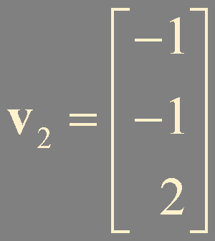
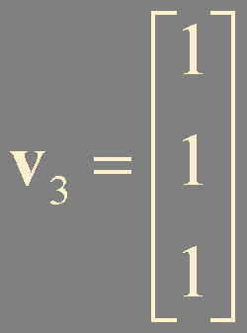
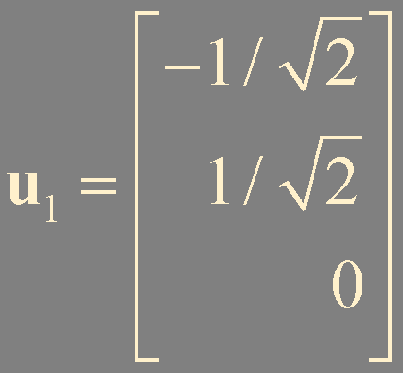
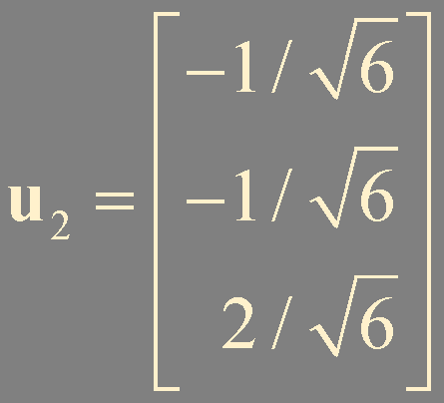
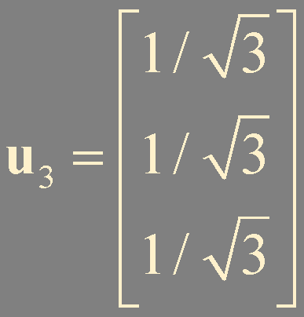
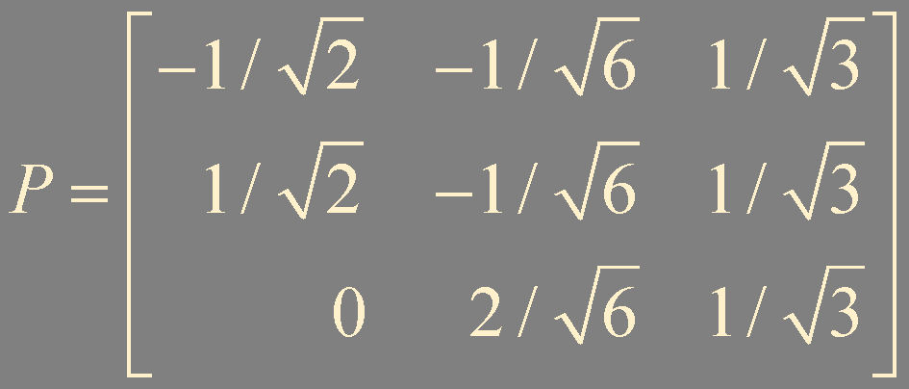

?
!
Example 2
Diagonalize the matrix A =
A^{T} = A
orthogonal
A = PDP⁻¹ = PDP^{T}

Slide 5












Theorem 1.
If A is symmetric, then
any two eigenvectors from different eigenspaces are orthogonal.

Slide 6
Orthogonally Diagonalizable
A matrix A is said to be orthogonally diagonalizable
if there are an orthogonal matrix P with P⁻¹ = P^{T} and a diagonal matrix D such that
A = PDP^{T} = PDP⁻¹
orthonormal
If A is orthogonally diagonalizable
A = PDP^{T}
A^{T} = (PDP^{T})^{T}
= P^{TT}D^{T}P^{T}
= PDP^{T}
A = A^{T}
A is symmetric !

Slide 7
Theorem 2.
An n × n matrix A is orthogonally diagonalizable if and only if
A is a symmetric matrix.
only if

Slide 8

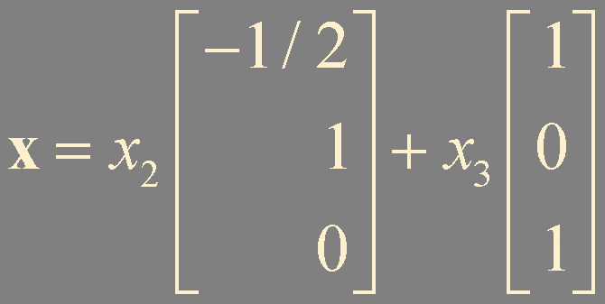
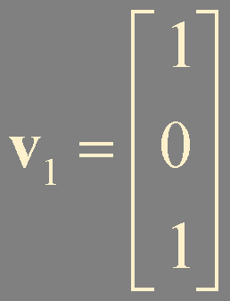
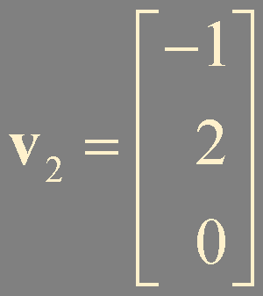
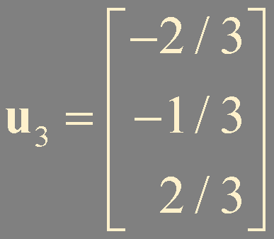
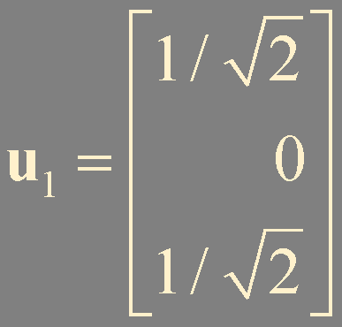
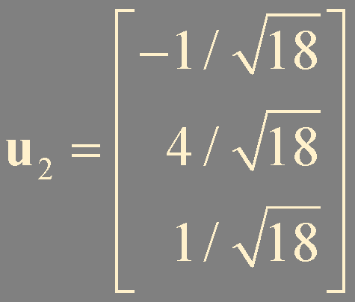
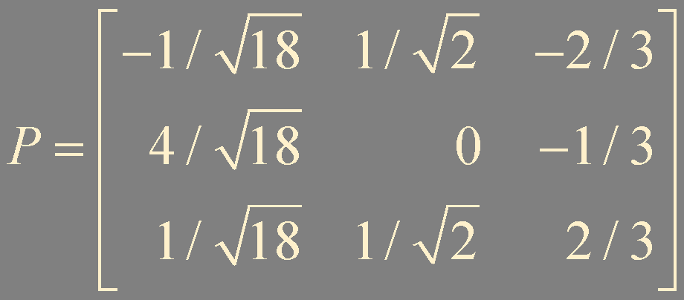

?
!
Example 3
Orthogonally diagonalize the matrix
Ch 4.3 Theorem 6.
orthogonally
diagonalizable
diagonalizable
λ = 7 with multiplicity = 2
λ = -2 with multiplicity = 1
Span {v₁, v₂}
Span {u₁, u₂}
Gram-Schmidt

Slide 9
Steps: Orthogonally Diagonalization
Check if A^{T} = A
Calculate eigenspaces for distinct eigenvalues
Find orthogonal basis for each eigenspace by the Gram-Schmidt process
Obtain orthonormal basis by normalization
Construct P and D

Slide 10
Theorem 3. The Spectral Theorem for Symmetric Matrices
An n × n symmetric matrix A has the following properties:
a. A has n real eigenvalues, counting multiplicities
no need to be distinct
b. The dimension of the eigenspace for each eigenvalue λ equals the multiplicity of λ.
Ch 4.3
Theorem 4.
c. Eigenvectors corresponding to different eigenvalues are orthogonal
d. A is orthogonally diagonalizable.
* Proofs of a. and d. are given in the supplement.

Slide 11



True or False ?
An n × n matrix that is orthogonally diagonalizable must be symmetric.
If A^{T} = A and if vectors u and v satisfy Au = 3u and Av = 4v, then u⋅v = 0.
An n × n symmetric matrix has n distinct real eigenvalues.
Every symmetric matrix is orthogonally diagonalizable.
If B = PDP^{T}, where P^{T} = P⁻¹ and D is a diagonal matrix, then B is a symmetric matrix.
An orthogonal matrix is orthogonally diagonalizable.
The dimension of an eigenspace of a symmetric matrix equals the multiplicity of the corresponding eigenvalue.

Slide 12








Spectral Decomposition
Suppose A is orthogonally diagonalizable
n × n matrix
rank = 1
the spectrum (eigenvalues) of A
projection matrix
orthogonal projection x onto Span {u_{k}}

Slide 13


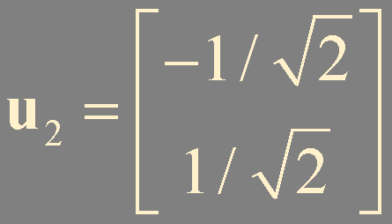



?
!
Construct a spectral decomposition of the matrix A that has the orthogonal diagonalization
Example 4

Slide 14
?
!
Show that if A is a symmetric matrix, then A² is symmetric.
Example 5
(A²)^{T} = (AA)^{T} = A^{T}A^{T}
= AA = A²
A = A^{T}
!
?
Show that if A is orthogonally diagonalizable, then so is A².
Example 6
A is symmetric
A² is symmetric

Slide 15
Summary
A symmetric matrix
Orthogonally diagonalizable
Spectral decomposition

